Slide 1

Stock Price Predictor and Recommendations Using LSTM Network
Haniya Akhtar (22106130)
Ritik Pandey (22106054)
Hrishikesh Kharkar (22106002)
Sumedh Gadpayle (22106076)
Project Guide
Prof. Nirali Arora

Slide 2
Outline
Introduction
Literature Survey of the Existing Systems
Limitations of the Existing Systems
Problem Statement
Framework/Algorithm
Proposed System Design
Future Scope
Implementation(Partial)
Conclusion
References

Slide 3
Introduction
The stock market's high volatility makes accurate predictions a significant challenge, and linear regression often fail to capture the full complexity of market behavior. Current challenges include frequent errors in predictions due to unexpected market fluctuations, and traditional models struggle with processing large amounts of historical data, leading to unreliable long-term forecasts. These limitations highlight the need for advanced approaches like LSTM networks, which excel in time series forecasting. The goal is to enhance prediction accuracy and offer actionable investment recommendations by leveraging LSTM's ability to learn from past data.

Slide 4
Literature Survey of the existing system
Author Name | Publisher Name | Year | Information
Adil Moghar , Mhamed Hamiche | Procedia Computer Science | 2020 | Long Short-Term Memory (LSTM) is one of many types of Recurrent Neural Network RNN, it’s also capable of catching data from past stages and use it for future predictions . In general, an Artificial Neural Network (ANN) consists of three layers: 1) input layer, 2) Hidden layers, 3) output layer.

Slide 5
Literature Survey of the existing system
Author Name | Publisher Name | Year | Information
Risheng QiaoORCID Icon,Weike Chen &Yongsheng | Applied Artificial Intelligence | 2017 | For a long time, the prediction of future stock price trend and stock return has been an active research field. All investors and researchers hope to achieve the goal of predicting future stock price trend and stock return (Zhong and Enke Citation2017).

Slide 6
Literature Survey of the existing system
Author Name | Publisher Name | Year | Information
S. Dinesh , A.M.S. Rama Raju , S. Rahul , O. Naga Sandeep , Mr. N D S S Kiran Relangi | Mukt Shabd Journal | 2021 | Stock price prediction is challenging due to market volatility, but Long Short-Term Memory (LSTM) networks, designed for time series problems, outperform other models like Logistic Regression and ARIMA, achieving over 93% accuracy in stock price forecasting.

Slide 7
Literature Survey of the existing system
Author Name | Publisher Name | Year | Information
Bhandari, H. N., Rimal, B., Pokhrel, N. R., Rimal, R., Dahal, K. R., & Khatri, R. K | Machine Learning with Applications | 2022 | This study uses LSTM networks to predict the next-day closing price of the S&P 500 index, leveraging nine key predictors from market, macroeconomic, and technical data. Single-layer and multilayer LSTM models are compared, with the single-layer model showing superior accuracy based on RMSE, MAPE, and Correlation Coefficient metrics.

Slide 8
Limitations of Existing Systems
High Computational Cost:
LSTMs are computationally intensive, requiring significant processing power and time for training.
Difficulty Capturing External Factors:
Struggles with sudden market changes caused by unforeseen events not reflected in historical data.
Model Interpretability:
LSTMs are "black boxes," making their decision-making process difficult to interpret and understand.

Slide 9
Problem Statement
The project aims to enhance stock price prediction accuracy using LSTM networks, which can better capture long-term dependencies in market data. The LSTM-based approach is expected to outperform traditional methods by managing the complexities of stock market patterns. However, challenges such as data dependency, high computational costs, and limited interpretability must be addressed.

Slide 10
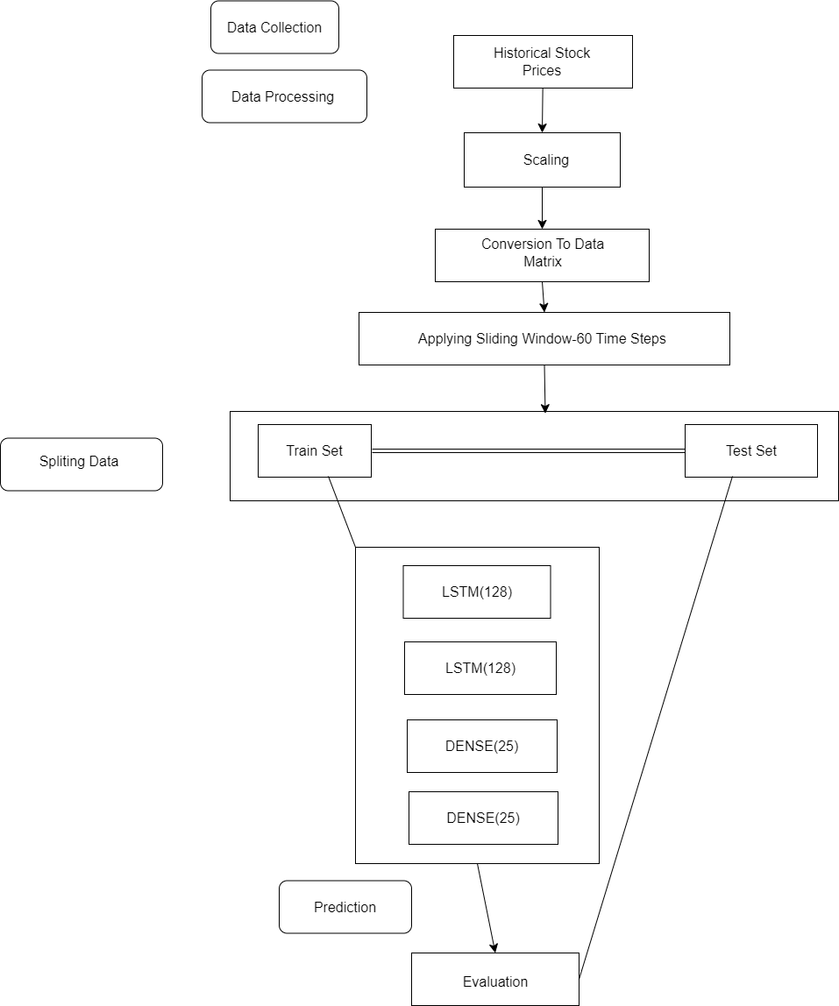
Framework/Algorithm

Slide 11
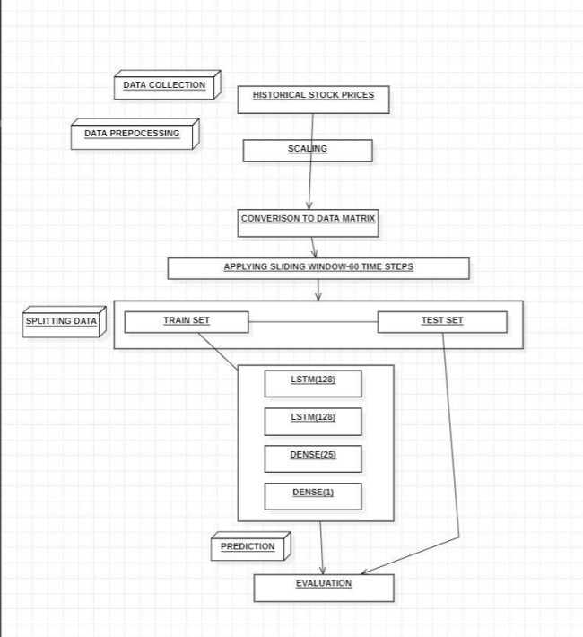
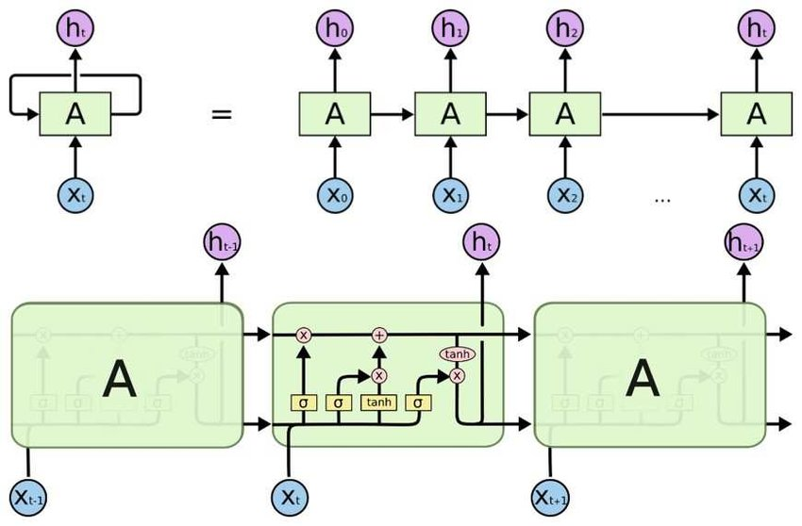
Proposed System Design

Slide 12






Technology used

Slide 13
Future Scope
1. Broker Networking Interface:
A proper interface for brokers to connect and network with fellow users on the platform can help them share insights, strategies, and trends. This collaborative environment will assist brokers in making better, informed decisions, leveraging collective expertise.
2. Integrated Mutual Funds & SIP Calculator:
Merging the mutual funds and SIP calculators with real-time stock data can display growth trends in an accelerated format. By tracking real-time market movements, the platform can recommend the most suitable investment options based on the user’s input parameters, ensuring informed and timely investment decisions.
3. Real-Time Stock Recommendations:
Leveraging real-time stock data with predictive analytics can recommend mutual funds and SIP investments that align with market dynamics and projected growth. This helps users optimize their portfolios by dynamically adjusting to market conditions and offering the best potential returns.

Slide 14


Implementation

Slide 15




Slide 16
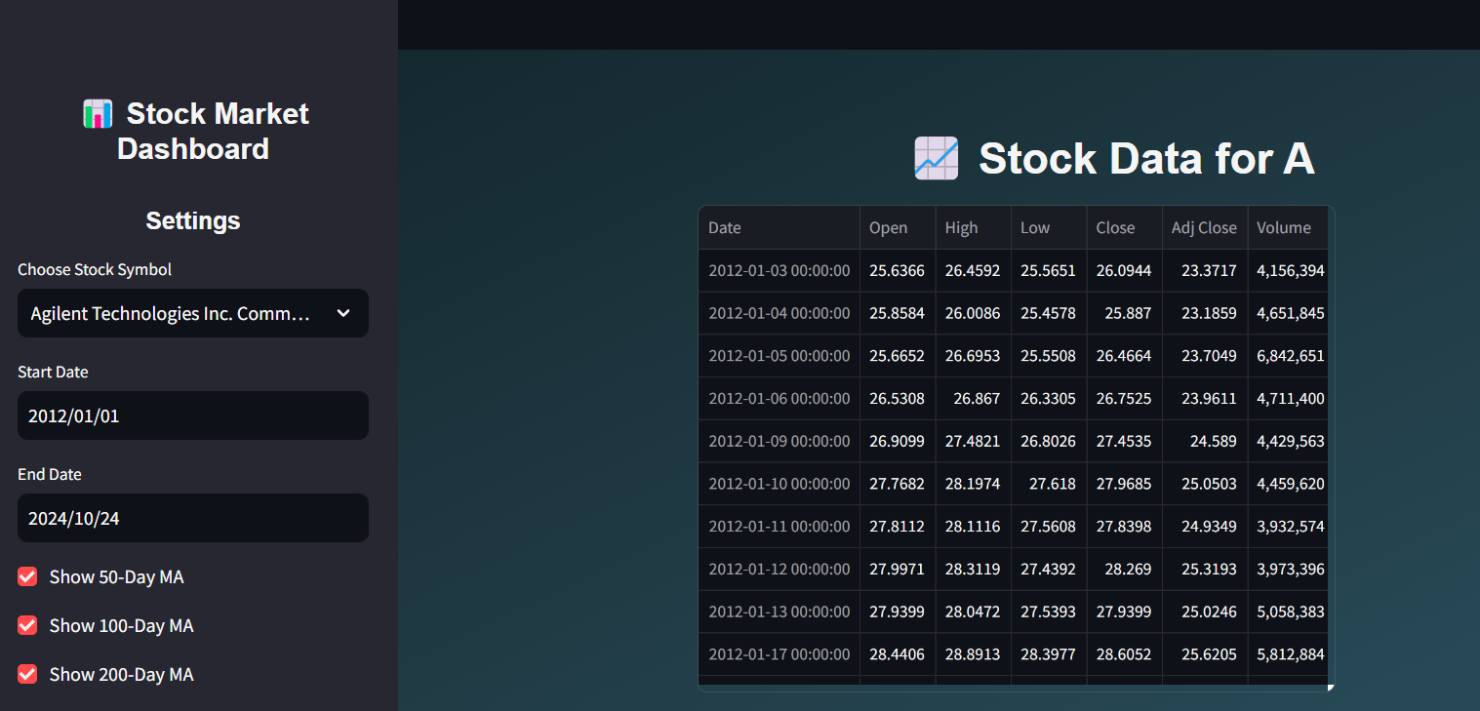
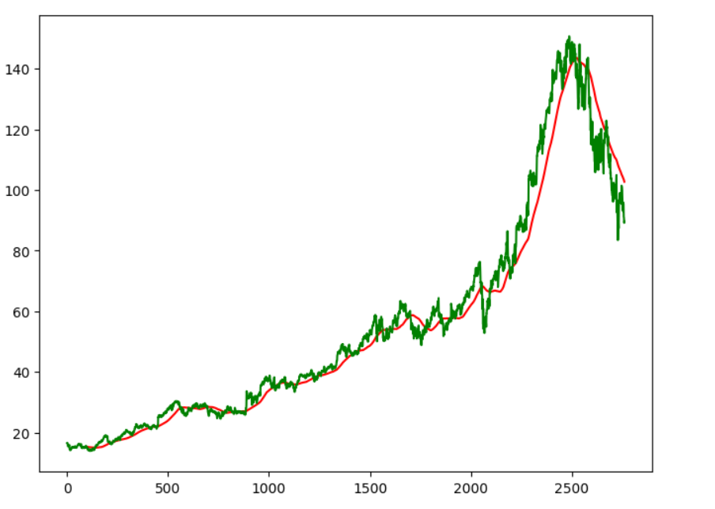
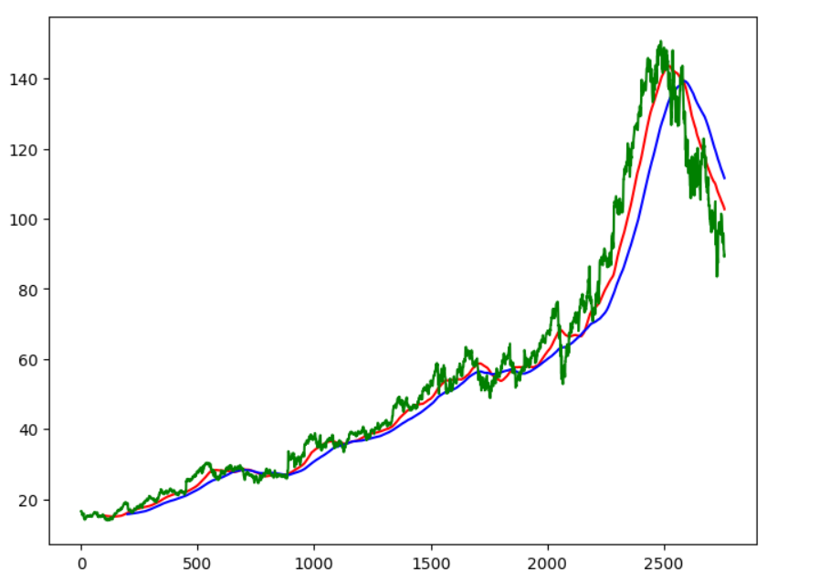

Slide 17
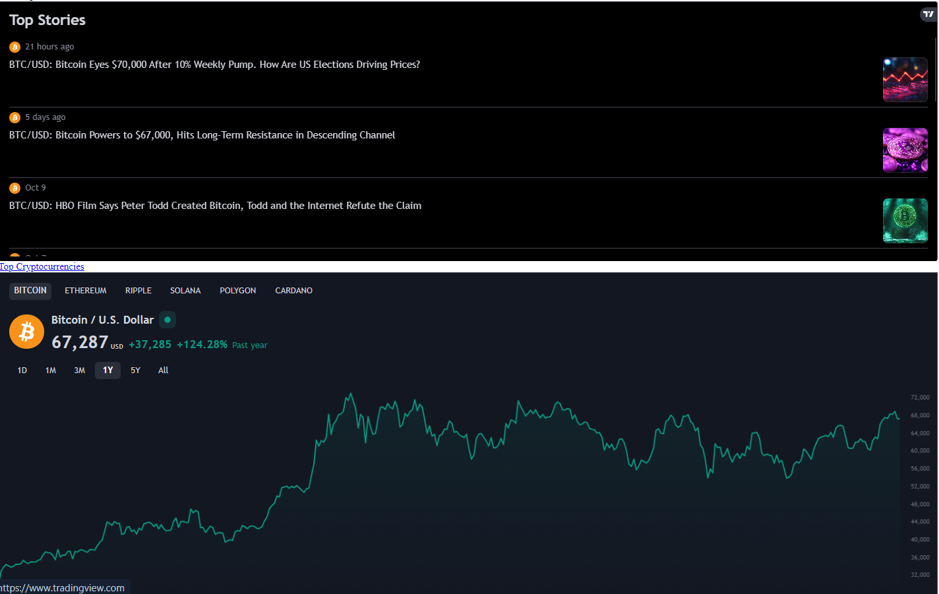
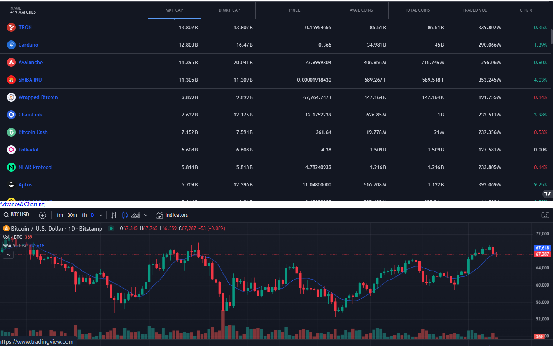

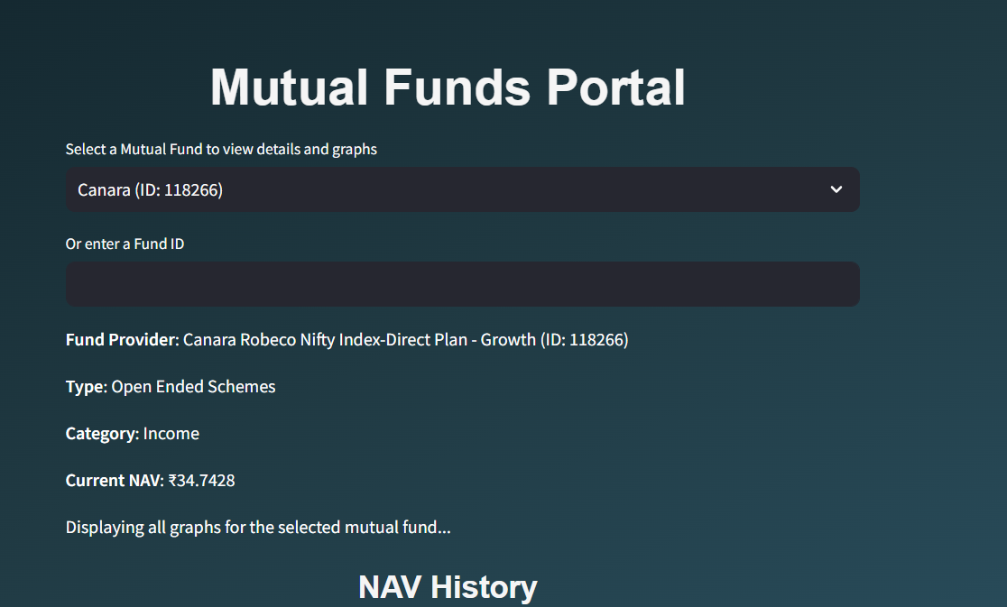

Slide 18
Conclusion
In conclusion, LSTM networks offer a promising solution for improving stock market predictions by capturing long-term dependencies and adapting to market volatility. However, challenges like data dependency, high computational costs, and limited interpretability must be addressed. Enhancing data quality, optimizing computations, and improving model transparency will be crucial for developing a robust and reliable forecasting tool.

Slide 19
References
Stock Market Prediction Using LSTM Recurrent Neural Network by Adil Moghar , Mhamed Hamiche. [1]
Prediction of stock return by LSTM neural network by Risheng QiaoORCID Icon,Weike Chen &Yongsheng. [2]
Stock price prediction using LSTM by S Dinesh, S Rahul, O Sandeep, K Relangi, AMS Rama Raju
Predicting stock market index using LSTM by HN Bhandari, B Rimal, NR Pokhrel, R Rimal, KR Dahal, RKC Khatri

Slide 20
Thank You

